Slide 1
OSGI
What is OSGI
OSGI Architecture
Deployment model
Container

Slide 2
OSGI
OSGi (Open Service Gateway Initiative) is a Java framework for developing and deploying modular software programs and libraries.

Slide 3
Trend
Application tend to grow bigger
Agile methodology

Slide 4
Challenges
Dependency Management
Versioning
Deployment
Maintenance

Slide 5
Some more challenges
Zero downtime
Modular deployment
Version

Slide 6
Design terms
Loose coupling
High cohesion
Divide and conquer
Separation of concern

Slide 7
Runtime modularity
Jar file is runtime modularity
Issues
  a Jar is missing
  there is one Jar too many
  a class is not visible where it should be

Slide 8
OSGI
Specification for modular components called bundles
  defines an infrastructure for a bundle's life cycle
  determines how bundles will interact.
Java Virtual Machine (JVM)-level service registry to
  Publish
  discover
  bind

Slide 9
OSGI framework Bundles
• Open Services Gateway initiative – now known as the OSGi Alliance
•OSGi technology is the dynamic module system for Java™
•The OSGi Service Platform provides functionality to Java that makes Java the
premier environment for software integration and thus for development.
•Java provides the portability that is required to support products on many
different platforms while the OSGi technology provides the standardized
primitives that allow applications to be constructed from small, reusable and
collaborative components.
•These components can be composed into an application and deployed.

Slide 10
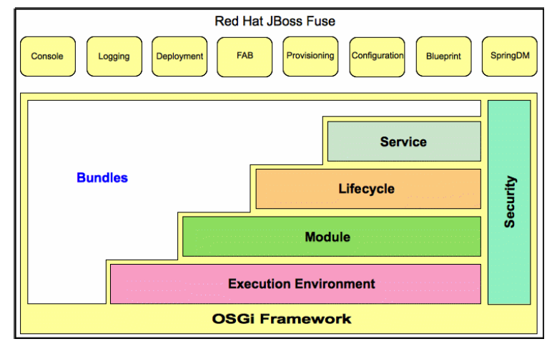
OSGI framework Architechture

Slide 11
OSGI framework
• Execution Environments
•Execution environment is the specification of the Java environment
•Modules
•Modules layer defines the class loading policies. The OSGi Framework is
a powerful and rigidly specified class-loading model. It is based on top of
Java but adds modularization
•Life Cycle Management
•Life Cycle layer adds bundles that can be dynamically installed, started,
stopped, updated and uninstalled
•Service Registry
•The service registry provides a cooperation model for bundles that takes
the dynamics into account

Slide 12
OSGI framework
• Bundles - Bundles are the OSGi components made by the developers.
•Services - The services layer connects bundles in a dynamic way by offering
a publish-find-bind model for plain old Java objects.
•Life-Cycle - The API to install, start, stop, update, and uninstall bundles.
•Modules - The layer that defines how a bundle can import and export code.
•Security - The layer that handles the security aspects.
•Execution Environment - Defines what methods and classes
specific platform.
are available in a

Slide 13
OSGI framework Bundles
• A bundle is a self-describing collection
The specification of a bundle’s contents and requirements is given in its
manifest file, META-INF/MANIFEST.MF. The manifest follows the standard
JAR manifest syntax but adds a number of OSGi-specific headers

Slide 14

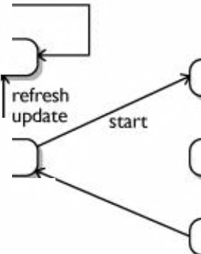

OSGI framework Bundles lifecycle
•OSGi is fundamentally a dynamic technology. Bundles can be installed,
started, stopped, updated, and uninstalled in a running system
•To support this, bundles must have a clear lifecycle, and developers need
ways of listening
to and hooking
into the various lifecycle states of a bundle
•Every bundle starts it runtime life in the installed state
•From there it becomes resolved if all of its dependencies are met
•Once a bundle is resolved, its classes can be loaded and run
•If a bundle is subsequently started and transitions to
the active state, it can participate in its lifecycle by having
update
refresh
D
nmstalt
INSTALLED
STARTING
resolve
policy
an activator
• Using the activator, the bundle can initialize itself, acquire
required resources, and hook in with the rest of the system
•on system shutdown—active bundles get stopped.
•Bundles with activators have a chance to free any resources
they may have allocated
•Bundles transition back to the resolved state when they are
stopped. From there they may be restarted or uninstalled, at which time the
uninstall
RESOLVE
ACTIVE
u
stop
U
N INSTALLED
STOPPING

Slide 15
OSGI framework Module
•An OSGi bundle provides a clear definition of its modularity—this
identity, its requirements, and its capabilities.
includes its
•The Bundle-SymbolicName
defining identity.
and
Bundle-Versionmanifest headers
take care of
Manifest-Version: 1.0
Buncl1e-ManifestVersion: 2
Buncl1e-llame: Sample service
Buncl1e-Syrnbolicllam.e: sample
Bundle
Activator
Manifest-Version:
1.0
impl_bundle
service imp! bundle
Bundle-ManifestVersion:
2
Bundle-Harne:
Saniple_service_bundle
Buncl1e-Version: 1.0.1.qualifier
Buncl1e-Activator: sample_service impl_bundle.Activator
Buncl1e-ActivationPolicy: lazy
Buncl1e-RequiredExecutionEnvirornnent:JavaSE-1.6
Import-Package: org.osgi. framework; ve.rsi on=" 1. 3 . 0"
Require-Buncl1e: sample service bundle; bundl e-ve.rsi on=" 1. 0. 0"
Bundle-SymbolicHame:
sample service
bundle
Bundle-Version:
1.0.0.qualifier
Bundle-Requ.iredExecutionEnviromnent:
JavaSE-1.6
Export-Package:
I
com.test.service.contract
Export
Packages
Import
Packages
Required
Bundle
•The OSGi framework resolves the dependencies and wires bundles together at runtime.
•Modularity in an OSGi system is enforced through a combination of wires and standard
Java language visibility rules.
•To manage this, the framework gives each bundle its own class loader.
•This keeps separate the classes from the different bundles.
•When a bundle is uninstalled or updated, its class loader, and all classes loaded by it, are

Slide 16
•Eclipse
•NASA
• The only Service Oriented Architecture standard for embedded systems
•Spring Dynamic Module Server is based on OSGi bundles,
enterprise bundle repository accessible at
http://www.springsource.com/repository/app/
and
provides
•Apache Tuscany SOA project
•JBOSS
•IBM WebSphere being reworked as OSGi application

Slide 17
?
Why use osgi
• very clean and isolated class-loading mechanisms. One class
version per class loader
name and
• Enables Collaboration
•Modularity
•OSGi technology provides
for Java
a proven service-oriented, dynamic
module
system
• Robust, mature and consistent service programming model
• Modular execution environment for services and applications

Slide 18


Why use osgi
▪
Log Service – The logging of information, warnings, debug information or errors is handled through the Log
Service. It receives log entries and then dispatches these entries to other bundles that subscribed to this information.
Configuration Admin Service – This service provides a flexible and dynamic model to set and get configuration information.
Device Access Service – Device Access is the OSGi mechanism to match a driver to a new device and automatically download a bundle implementing this driver. This is used for Plug and Play scenarios.
User Admin Service – This service uses a database with user information (private and public) for authentication and authorization purposes.
IO Connector Service – The IO Connector Service implements the CDC/ CLDC javax. microedition.io package as a service. This service allows bundles to provide new and alternative protocol schemes.
Preferences Service – This service provides access to hierarchical database of properties, similar to the
Windows Registry or the Java Preferences class.
Component Runtime – The dynamic nature of services -- they can come and go at any time -- makes writing software harder. The Component Runtime specification can simplify handling these dynamic aspects by providing an XML based declaration of the dependencies.
Deployment Admin – The primary deployment format for OSGi is the bundle, which is a JAR/ZIP file. The Deployment Admin provides a secondary format: the deployment package. Deployment Packages can combine bundles with arbitrary resources into a single deliverable that can be installed and uninstalled. A comprehensive model of resource processors allows user code to extend the resource types.
Event Admin – Many OSGi events have specific typed interfaces, making it hard to receive and filter events generically. The Event Admin provides such a generic, topic-based event mechanism. The specification includes mapping for all existing framework and service events.
Application Admin – The OSGi bundle model is different from the typical desktop or mobile phone application model that relies on starting and stopping applications. The Application Admin prescribes such a traditional application model and its required management infrastructure.
▪
▪
▪
▪
▪
▪
▪
▪
▪

Slide 19
• Equinox
•Felix
•JBOSS
OSGi

Slide 20
Container
Parameters
Equinox
JBOSS
OSGi
Felix
Core Spec
./
./
./
Remote Services
./
./
./
Log Services
./
./
./
Http Services
./
./
./
./
Configuration Admin
./
./
Event Admin
./
./
./
Monitor Admin
)(
./
./
IO Connector Service
./
./
)(
Blueprint Container Integration
)(
./
./
Tracker Services
./
./
./
XML Parser Service
)(
./
)(
Remote Service Admin
./
./
./
JTA Transaction Services
)(
./
)(
JMX Management Services
)(
./
)(
JDBC Service
)(
)(
)(
JNDI Services
)(
./
)(
JPA Services
)(
)(
)(
Hibernate Integration
)(
)(
)(

Slide 21
OSGI Development
▪
Use Eclipse PDE for OSGi bundle development
OSGi build can be maven enabled, plugin provided
Felix
▪
by apache
▪
Bundle version used for build and deployment, ranking used for
service implementation selection from service registry

Slide 22
OSGI Container
•Recommended approach to expose services bundles to web applications, is by use of CSF DOSGi bundle
•The CXF DOSGi bundle exposes the services as web services by using embedded jetty server

